Slide 1
My capstone project
Janvi Krishnan​:
Beginner course-python

Slide 2
Introduction
Hello everyone , I made this presentation to showcase a few of the features that I have used in my project, some of which we didn’t learn during our course. This also includes my takeaway which I am keen to share with all of you.

Slide 3
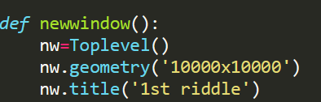
1. To open A new window
This function is used to create a
new window on which, in my case, displays a new riddle.
    I have used it to create the illusion
that when we choose the correct answer, the next door opens, and a new riddle is displayed.
Notes:
. 2nd image, show label that new window, write name window want display, in this case, nw(the name of window).

Slide 4
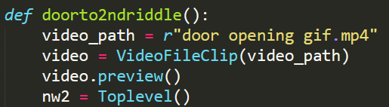
2. Creating a function
e
For creating a function, we use
the syntax def, and then the
name of our function.
Then, we call our function
anywhere we need it.
Notes:
In this case, on pressing button 9, we have called the function doorto2ndriddle.

Slide 5
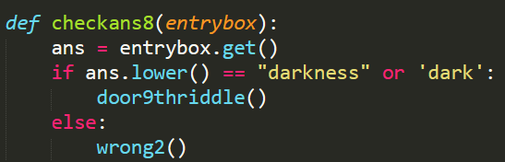
3. Checking an entrybox answer
To check an entry box answer, we first make an entry box, then we create another variable to get the answer that the user wrote, syntax is .get().
Then, we use the if command to check whether the answer is correct.
We use the .lower() command to convert the user’s answer to all lower
case, then the program checks it with the answer that we wrote.
if all the parameters are satisfied, it activates next riddle in this case.

Slide 6

4. Playing the video
This one was the most difficult task to complete, as it took about a 100 different tries to get it to function correctly.
This function enables us to display a
video in the game. This is the syntax
for it.
Notes:
It actually felt like a full time job, on my resume, ill put coding class under job experience. Jokes aside, for this, a huge thank you to Sharanya ma’am for helping me.

Slide 7
How I have improved
This course has benefitted me in so many ways and taught me so many things :
During the capstone project I had to troubleshoot on almost everything and had to go at it until it was solved because of which my problem solving skills have increased at least ten-fold.
It has also taught me to push through tough times.
Last but not least, it taught me that I loved coding as much as my dad does.
Notes:
After tough times say laptop break down, test, holiday hw.

Slide 8
acknowledgements
Thank you to Sharanya maam and Abhinav sir for creating this amazing course . From the moodle course, to grok academy, to recording the classes, it is clearly visible how much planning and thoughtfulness has gone into it and I enjoyed it so much that I looked forward to each class with anticipation. This has been the most effective method of learning for me, and I hope to join the advanced batch.

Slide 9
THANK YOU
For watching

